Slide 1
Planet Bromaron
SOCK STUDIOS
Cameron Ogden
Stephen Bakalian

Slide 2
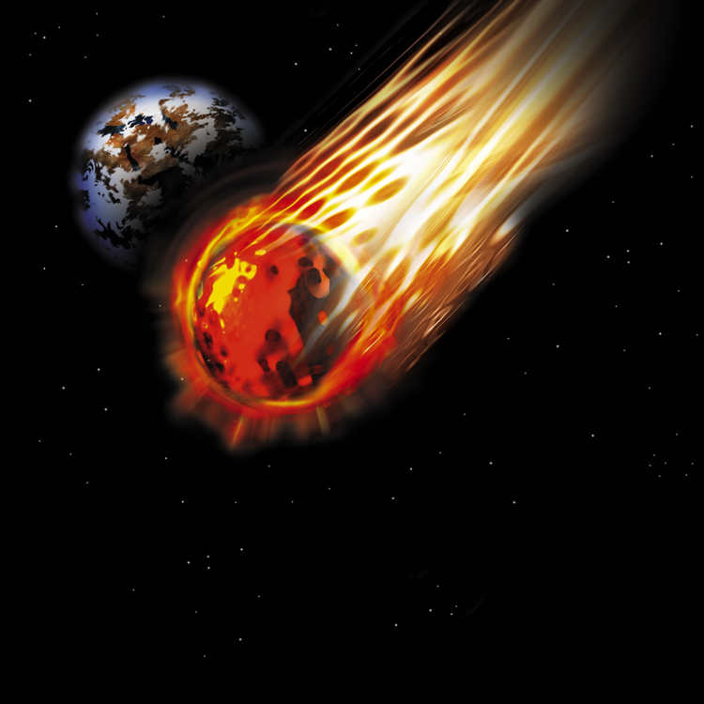
Planet Bromaron
Started off as an idea to make a 3D clone of Asteroids arcade shooter
It follows the idea but hasn’t fully become a clone
So far it has evolved into an minesweeper style of asteroids

Slide 3
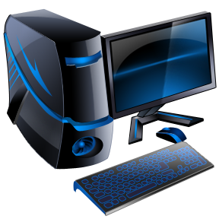
Implemented
First person quaternion camera
Basic lighting model
Randomized Spline logic
API for computer controlled entity
Game objects and environment
Collision between play and objects
1 Weapon system
Particle API

Slide 4
Assessing
Improved lighting and shading
Computer controlled entities
Improved environment
1 Weapon system
Weapon collision
Texture mapping
We have a lot of place holders which will be shown in the demo

Slide 5
Scheduled
Third person camera
XMMatrixLookAt vs XMMatrixLookTo
Importing a model
Hierarchical model
1 Weapon system
Full particle integration
Splash screen

Slide 6
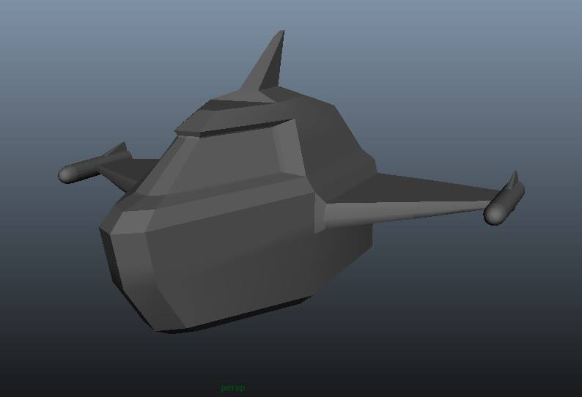
Mistakes
Taking COMP3004 with COMP3501
Spending to much time making our own 3d models
Focused more on the coding a little to late (early November)

Slide 7

Accomplishments
It compiles
Error handling
Most the API is in but not fully functional
Half finished computer controlled entity running off a spline

Slide 8
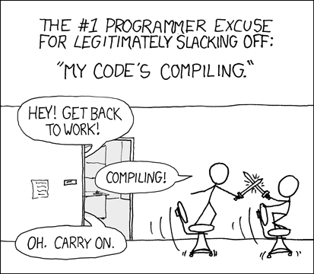
Demo

Slide 9
Questions?
Weeks of programming can save you hours of planning

